Slide 1
Puzzles to Puzzle You
Select start to begin.
Start
Notes:
Development Notes:
Disable default next button. The whole game/quiz will be navigated based on interactive buttons given on slide.
The storyboard uses custom interactivities and quizzes. Do not use default interactivities provided by captivate.
The screens in storyboard are for reference. Use Adobe captivate to its full potential to mimic the storyboard.
Image ID:
The images will be provided.

Slide 2










Select Puzzle 1 to Begin
Notes:
Development Notes:
Use 2 image grids of 5 image each, uncheck the body and subtitle and use the images as shown.
Puzzle 1 will be unlocked initially, upon completing/visiting the puzzle 1, puzzle 2 will be unlocked and so on.
Use the unlock images from puzzle 2 onwards as image state for each puzzle on this screen.
Use variables to toggle to the unlock state.
Image ID:
NA

Slide 3
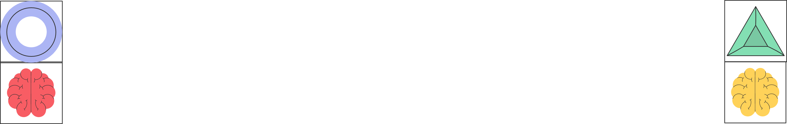
Puzzle 01
Can you crack the code and unlock the secret combination?
3
6
8
One number is correct and well placed
3
8
7
Nothing is correct
2
7
6
One number is correct but wrongly placed
4
7
1
Two numbers are correct but wrongly placed
?
?
?
Enter your answer here.
Check
Notes:
Development Notes:
This will appear upon clicking puzzle01 image from screen 2.
Use title and image block.
The whole puzzle will go as an image.
Add an input filed to enter the answer.
Use a true/false variable named puzzle1. as soon as learner visit this slide, set the variable value to true.
Upon clicking check button, navigate to slide 4 to show correct answer.
Adjust the elements shown on screen as per Adobe captivate capabilities.
Provide a home button to go back to screen 2.
Image ID:

Slide 4
Puzzle 01
Can you crack the code and unlock the secret combination?
3
6
8
One number is correct and well placed
3
8
7
Nothing is correct
2
7
6
One number is correct but wrongly placed
4
7
1
Two numbers are correct but wrongly placed
1
6
4
Enter your answer here.
Check
Notes:
Development Notes:
This is the continuation from previous screen.
Correct answer is 164.
Any other combination entered by learner would be wrong.
Change the image state of the question with lock upon entering correct answer only.
Image ID:

Slide 5
Puzzle 01
Can you crack the code and unlock the secret combination?
3
6
8
One number is correct and well placed
3
8
7
Nothing is correct
2
7
6
One number is correct but wrongly placed
4
7
1
Two numbers are correct but wrongly placed
*
*
*
Enter your answer here.
Check
Notes:
Development Notes:
This is the continuation from previous screen.
Change state of the question image to this to show incorrect answer.
Image ID:
NA

Slide 6
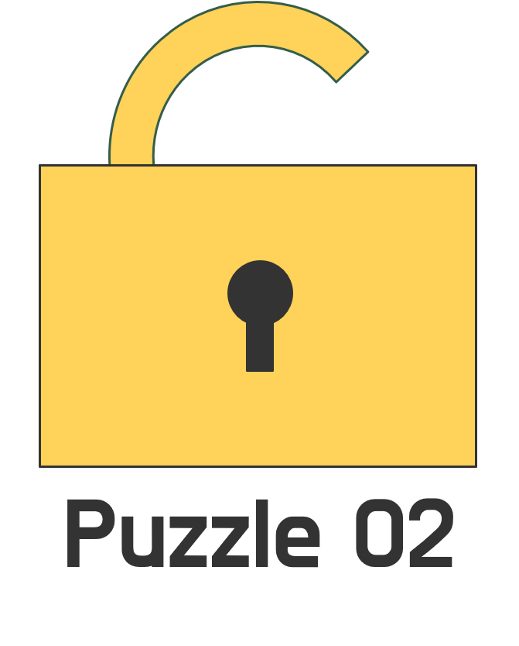
Select Puzzle 2 to Continue
Notes:
Development Notes:
Same as screen 2.
The UI is changed and puzzle 2 is unlocked.
If value of puzzle 1 is true, change image state of puzzle 2 to unlocked one.
The state of title will also change as the levels get unlocked.
Please do not repeat the screens unnecessary. The image states should be changed on screen 2 itself.
Image ID:
NA

Slide 7
Puzzle 02
Select the corret answers for these riddles
If A is the father of C,
D is the son of B,
E is the brother of A and C is the sister of D.
What is B then of E?
A man is twice as old as his little sister and half as old as their dad. Over a period of 50 years, the age of the sister will become half of their dad’s age. What is the age of the man now?
If a clock shows the time as 3:45, what will be the mirror image of this time?
Sister-in-law
56
8:15
Sister
52
7:15
Notes:
Development Notes:
This will appear upon clicking puzzle02 image from screen 2.
Use title and three column template.
Use 2 rows for three buttons aligned with the three columns.
Use a true/false variable named puzzle2. as soon as learner visit this slide, set the variable value to true.
Correct answers are given on next screen.
As soon as learner clicks the button, the color of the button will change to yellow as shown on next screen.
If learner selects wrong answer, the color will remain red only as shown.
Provide a home button to go back to screen 2.
Image ID:

Slide 8
Puzzle 02
Select the corret answers for these riddles
If A is the father of C, D is the son of B, E is the brother of A and C is the sister of D.
What is B then of E?
A man is twice as old as his little sister and half as old as their dad. Over a period of 50 years, the age of the sister will become half of their dad’s age. What is the age of the man now?
If a clock shows the time as 3:45, what will be the mirror image of this time?
Sister in law
52
8:15
Notes:
Development Notes:
This is the continuation from previous screen.
Only correct answers are shown.
Image ID:
NA

Slide 9

Select Puzzle 3 to Continue
Notes:
Development Notes:
Same as screen 2.
The UI is changed and puzzle 3 is unlocked.
If value of puzzle 2 is true, change image state of puzzle 3 to unlocked one.
The state of title will also change as the levels get unlocked.
Please do not repeat the screens unnecessary. The image states should be changed on screen 2 itself.
Image ID:
NA

Slide 10
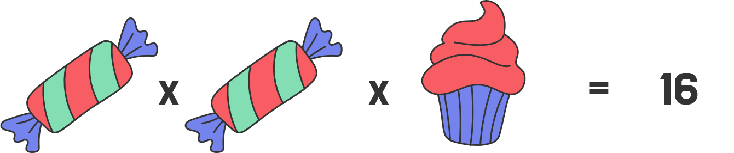
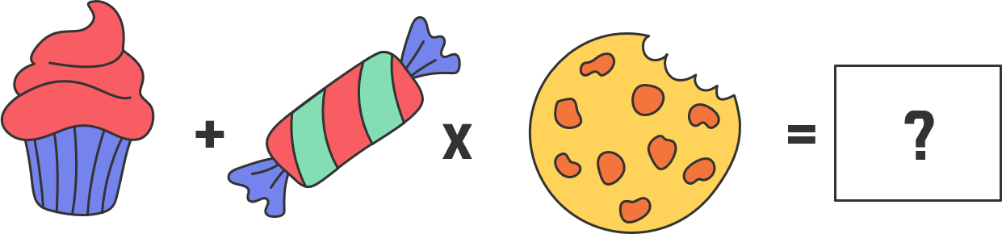
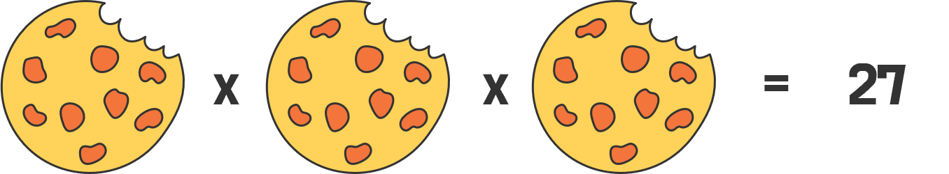
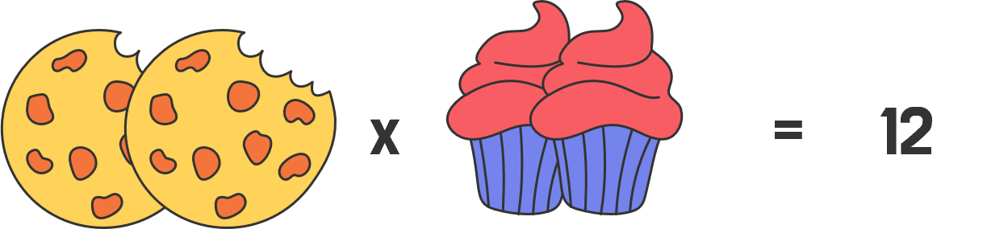
Puzzle 03
Select the number that will replace question mark?
13
14
Check
Notes:
Development Notes:
This will appear upon clicking puzzle03 image from screen 2.
Use title, image grid horizontal option to display the three images, and radio groups for answer options.
Use a true/false variable named puzzle3. as soon as learner visit this slide, set the variable value to true.
Correct answers are given on next screen.
Provide a home button to go back to screen 2.

Slide 11
Puzzle 03
Select the number that will replace question mark?
13
14
Check
Notes:
Development Notes:
This is the continuation of previous screen.
Correct answer is highlighted in yellow.
Incorrect answer is highlighted in red.

Slide 12

Select Puzzle 4 to Continue
Notes:
Development Notes:
Same as screen 2.
The UI is changed and puzzle 4 is unlocked.
If value of puzzle 3 is true, change image state of puzzle 4 to unlocked one.
The state of title will also change as the levels get unlocked.
Please do not repeat the screens unnecessary. The image states should be changed on screen 2 itself.
Image ID:
NA

Slide 13
Puzzle 04
What number will replace question mark?
5
3
8
40
33
?
1
7
9
2
3
6
Enter your answer here.
Check
Notes:
Development Notes:
This will appear upon clicking puzzle04 image from screen 2.
Use a true/false variable named puzzle4. as soon as learner visit this slide, set the variable value to true.
Correct answers are given on next screen.
Provide a home button to go back to screen 2.
Use title, image to display the question, and input field to enter the answer.

Slide 14
Puzzle 04
What number will replace question mark?
5
3
8
40
33
72
1
7
9
2
3
6
Enter your answer here.
Check
Notes:
Development Notes:
This is the continuation from previous screen.
Change state of the question image to this to show incorrect answer.
Correct answer is 72.

Slide 15
Puzzle 04
What number will replace question mark?
5
3
8
40
33
*
1
7
9
2
3
6
Enter your answer here.
Check
Notes:
Development Notes:
This is the continuation from previous screen.
Change state of the question image to this to show incorrect answer.
Correct answer is 72.
Any other option entered in the input will change to this image state of the question.

Slide 16

Select Puzzle 5 to Continue
Notes:
Development Notes:
Same as screen 2.
The UI is changed and puzzle 5 is unlocked.
If value of puzzle 4 is true, change image state of puzzle 5 to unlocked one.
The state of title will also change as the levels get unlocked.
Please do not repeat the screens unnecessary. The image states should be changed on screen 2 itself.
Image ID:
NA

Slide 17
Puzzle 05
Three boxes are placed on a table. Box A contains 1 red ball, 1 blue ball, and 1 green ball. Box B contains 2 red balls and 1 blue ball, while Box C contains 1 green ball and 2 blue balls. If you randomly choose one ball from Box A, what is the probability of drawing a blue ball?
Box A
Box B
Box C
1/3
2/3
2/4
Notes:
Development Notes:
This will appear upon clicking puzzle05 image from screen 2.
Use a true/false variable named puzzle5. as soon as learner visit this slide, set the variable value to true.
Correct answers are given on next screen.
Provide a home button to go back to screen 2.
Use title and image with buttons as answer options.

Slide 18
Puzzle 05
Three boxes are placed on a table. Box A contains 1 red ball, 1 blue ball, and 1 green ball. Box B contains 2 red balls and 1 blue ball, while Box C contains 1 green ball and 2 blue balls. If you randomly choose one ball from Box A, what is the probability of drawing a blue ball?
Box A
Box B
Box C
1/3
2/3
2/4
Notes:
Development Notes:
This is the continuation from previous screen.
The correct answer is 1/3. Highlighted in yellow.
Other answer are incorrect.

Slide 19

Select Puzzle 6 to Continue
Notes:
Development Notes:
Same as screen 2.
The UI is changed and puzzle 6 is unlocked.
If value of puzzle 5 is true, change image state of puzzle 5 to unlocked one.
The state of title will also change as the levels get unlocked.
Please do not repeat the screens unnecessary. The image states should be changed on screen 2 itself.
Image ID:
NA

Slide 20
Puzzle 06
The water level in a reservoir is low, but doubles every day. It takes 60 days to fill the reservoir. How long does it take for the reservoir to become half full?
30
45
59
Check
Notes:
Development Notes:
This will appear upon clicking puzzle06 image from screen 2.
Use a true/false variable named puzzle6. as soon as learner visit this slide, set the variable value to true.
Correct answers are given on next screen.
Provide a home button to go back to screen 2.
Use radio group to give the options with the button.

Slide 21
Puzzle 06
The water level in a reservoir is low, but doubles every day. It takes 60 days to fill the reservoir. How long does it take for the reservoir to become half full?
30
45
59
Check
Notes:
Development Notes:
This is the continuation from previous screen.
The correct answer is 59. Highlighted in yellow.

Slide 22

Select Puzzle 7 to Continue
Notes:
Development Notes:
Same as screen 2.
The UI is changed and puzzle 7 is unlocked.
If value of puzzle 6 is true, change image state of puzzle 7 to unlocked one.
The state of title will also change as the levels get unlocked.
Please do not repeat the screens unnecessary. The image states should be changed on screen 2 itself.
Image ID:
NA

Slide 23
Puzzle 07
You are in a room that has three switches and a closed door. The switches control three light bulbs on the other side of the door. Once you open the door, you may never touch the switches again. Drag and drop the correct sequence which definitively tell which switch is connected to each of the light bulbs?
Turn on the first two switches.
Go through the door. The lit light is linked to the first switch.
The bulb which is warm to the touch is connected to the second switch..
The bulb which is cold, is connected to the switch that was never turned on.
Turn off the second switch only after some time.
Check
Notes:
Development Notes:
This will appear upon clicking puzzle07 image from screen 2.
Use a true/false variable named puzzle7. as soon as learner visit this slide, set the variable value to true.
Correct answers are given on next screen.
Provide a home button to go back to screen 2.
Use title, image and drag and drop.
Use 5 drop targets and drag objects.

Slide 24
Puzzle 07
You are in a room that has three switches and a closed door. The switches control three light bulbs on the other side of the door. Once you open the door, you may never touch the switches again. How can you definitively tell which switch is connected to each of the light bulbs?
Turn on the first two switches.
Turn off the second switch only after some time.
Go through the door. The lit light is linked to the first switch.
The bulb which is warm to the touch is connected to the second switch..
The bulb which is cold, is connected to the switch that was never turned on.
Check
Notes:
Development Notes:
This is the continuation from previous screen.
The correct sequence is highlighted in yellow.

Slide 25

Select Puzzle 8 to Continue
Notes:
Development Notes:
Same as screen 2.
The UI is changed and puzzle 8 is unlocked.
If value of puzzle 7 is true, change image state of puzzle 8 to unlocked one.
The state of title will also change as the levels get unlocked.
Please do not repeat the screens unnecessary. The image states should be changed on screen 2 itself.
Image ID:
NA

Slide 26
Puzzle 08
What number will replace question mark?
7
10
8
11
9
12
10
13
?
Enter your answer here.
Check
Notes:
Development Notes:
This will appear upon clicking puzzle08 image from screen 2.
Use a true/false variable named puzzle8. as soon as learner visit this slide, set the variable value to true.
Correct answers are given on next screen.
Provide a home button to go back to screen 2.
Use title and input field.

Slide 27
Puzzle 08
What number will replace question mark?
7
10
8
11
9
12
10
13
11
Enter your answer here.
Check
Notes:
Development Notes:
This is the continuation from previous screen.
The correct answer is highlighted in yellow.
If entered 11, only then the color will be yellow.
If any other number entered, red will be highlighted.

Slide 28
Puzzle 08
What number will replace question mark?
7
10
8
11
9
12
10
13
*
Enter your answer here.
Check
Notes:
Development Notes:
This is the continuation from previous screen.
Show this if incorrect answer entered in input field.

Slide 29

Select Puzzle 9 to Continue
Notes:
Development Notes:
Same as screen 2.
The UI is changed and puzzle 9 is unlocked.
If value of puzzle 8 is true, change image state of puzzle 9 to unlocked one.
The state of title will also change as the levels get unlocked.
Please do not repeat the screens unnecessary. The image states should be changed on screen 2 itself.
Image ID:
NA

Slide 30

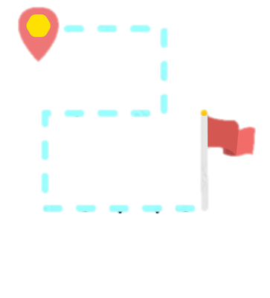
Puzzle 09
A person facing north turns 90 degrees clockwise, then 180 degrees counterclockwise, and then 270 degrees clockwise. In which direction is the person facing now?
East
West
North
South
Notes:
Development Notes:
This will appear upon clicking puzzle09 image from screen 2.
Use a true/false variable named puzzle9. as soon as learner visit this slide, set the variable value to true.
Correct answers are given on next screen.
Provide a home button to go back to screen 2.
Use title, image and buttons for correct answers.
Image ID:
203246741
203246740

Slide 31
Puzzle 09
A person facing north turns 90 degrees clockwise, then 180 degrees counterclockwise, and then 270 degrees clockwise. In which direction is the person facing now?
East
West
North
South
Notes:
Development Notes:
This is the continuation from previous screen.
The correct answer is highlighted in yellow.

Slide 32

Select Puzzle 10 to Continue
Notes:
Development Notes:
Same as screen 2.
The UI is changed and puzzle 6 is unlocked.
If value of puzzle 5 is true, change image state of puzzle 5 to unlocked one.
The state of title will also change as the levels get unlocked.
Please do not repeat the screens unnecessary. The image states should be changed on screen 2 itself.
Image ID:
NA

Slide 33
Puzzle 10
What five-letter word becomes shorter when you add two letters to it?
A
B
C
D
E
F
G
H
I
J
K
L
M
N
O
P
Q
R
S
T
U
V
W
Y
Z
Enter your answer here.
Check
Notes:
Development Notes:
This will appear upon clicking puzzle10 image from screen 2.
Use a true/false variable named puzzle10. as soon as learner visit this slide, set the variable value to true.
Correct answers are given on next screen.
Provide a home button to go back to screen 2.
Use title, image and input field.

Slide 34
Puzzle 10
What five-letter word becomes shorter when you add two letters to it?
S
H
O
R
T
A
B
C
D
E
F
G
H
I
J
K
L
M
N
O
P
Q
R
S
T
U
V
W
Y
Z
Enter your answer here.
Check
Notes:
Development Notes:
This is the continuation from previous screen.
The correct answer is highlighted in yellow.

Slide 35
Puzzle 10
What five-letter word becomes shorter when you add two letters to it?
*
*
*
*
*
A
B
C
D
E
F
G
H
I
J
K
L
M
N
O
P
Q
R
S
T
U
V
W
Y
Z
Enter your answer here.
Check
Notes:
Development Notes:
This is the continuation from previous screen.
Show this if incorrect answer is entered.

Slide 36

Congratulations
You unlocked each puzzle.
Exit
Notes:
Development Notes:
Show an overlay of screen 2. Show each level is unlocked.
Show message on screen with exit button.
Image ID:
116535551

